Slide 1



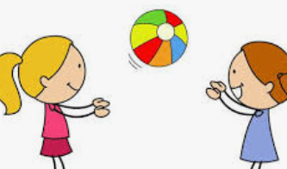


EYFS Newsletter
Summer 2 – 2025/26
Notices and Reminders
Library day – Monday
PE day – Monday
Please ensure children have a coat and a water bottle in school every day.
Key dates
June
Monday 1st June – Back to school
Friday 12th June – Happy Bag collection
Saturday 13th June – SANDFEST (PTA event)
Friday 19th June – Father’s Day –
(details to follow)
Wednesday 24th June – Sports Day
(details to follow) Reception – Yr2
Monday 29th June – Friday 3rd July – Community Week (details to follow)
Tuesday 30th June – Moving Up Day
July
Thursday 2nd July – Summer Disco (PTA event)
Friday 17th July – Zoolab Visit
Monday 20th – Tuesday 22nd July –
Feel Good Week (details to follow)
Tuesday 21st July – Ice Cream Van
Tuesday 21st July – Last day of term 1.30pm Pick Up
Wednesday 22nd July – INSET DAY
Communication and Language
This half term, the children will be building their confidence to speak to a wider range of adults within school. The children will learn and perform poems or songs to audiences.
The children will be learning about different tenses to talk about what is happening or has happened.
They will learn the difference
between a question and a
statement and use this to ask
and answer questions.
Physical Development
This term, the children will take part in fun team games to develop throwing accuracy, coordination, and simple scoring. They will learn to follow rules and instructions, move safely during tagging games, and practice skills in preparation for Sports Day. Their PD lessons will also support working cooperatively as a team, playing fairly against an opponent, and building confidence and enjoyment in physical activity.
Personal, Social and Emotional Development
The children will learn about the importance of friendship, saying sorry and forgiveness. They will also recognise that families can be different and that all families are based on love and care. As part of transition, the children will talk about which class they are moving to next year, who their new teacher will be and how they feel about the changes ahead.

Slide 2
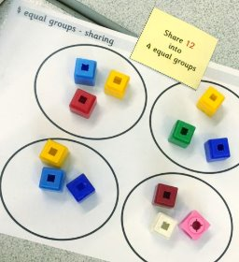



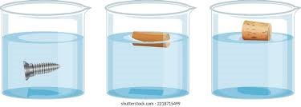





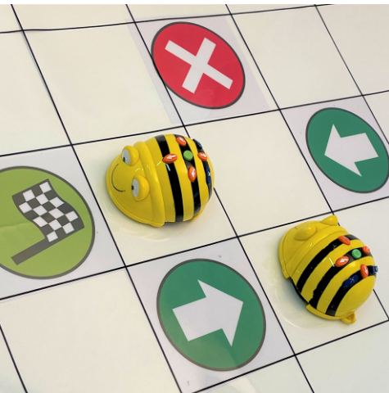


Literacy
In phonics, the children will continue to revise the sounds taught so far. They will be introduced to the beginning of phase 5 sounds and will have many opportunities to apply them in different contexts.
Rich texts will be used to develop the children's writing. They will orally rehearse them, act them out and begin to write them with a focus on finger spaces, capital letters and full stops.
Mathematics
The children will begin to explore the concepts of sharing and grouping. They will look at patterns and create their own patterns and rules to go with them. The children will be revisiting their learning of number bonds within 10 and consolidating their learning of addition and subtraction.
Understanding the World
The children will be exploring the differences and similarities between the past and present. The children will explore maps including recognising a map, how to use them and they will have the opportunity to create their own! The children will review their learning about the seasons and materials, including floating and sinking.
Expressive Arts and Design
The children will learn and perform sea shanties, move like sea animals in time to music and develop simple dance routines. The children will use collage to recreate artwork inspired by Paul Klee, review and improve their artwork and create their own compositions using tuned instruments such as xylophones. They will also be encouraged to discuss, evaluate and adapt their work as they learn.
Computing
This half term, the children will be exploring how a floor robot works. They will learn to follow and give instructions to help the robot complete a task. The children will also predict where the robot will move on a map when following a set of instructions.
Suggested books for reading

