Slide 1




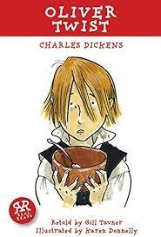
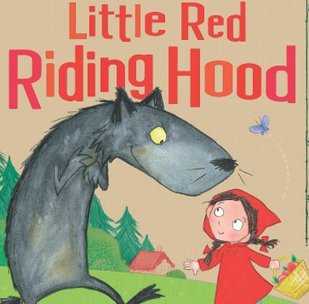
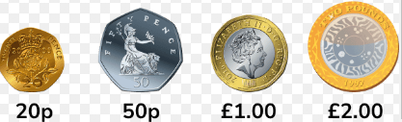
Year 2 Newsletter
Spring 1—2024/2025
Notices and Reminders
Happy new year and a warm welcome to 2025! We hope you enjoyed a wonderful break filled with lots of fun and laughter with friends and family. As the colder weather continues, please make sure that your child wears the correct winter uniform to school every day. For further information, please visit:
https://www.sandringham.kite.academy/parents/uniform/
Key Dates
Monday 6th January – start of spring 1 half term
Thursday 9th January – PTA movie night
Wednesday 15th January – Y1 Owls parent lunch (12:30pm)
Friday 17th January – INSET day
Wednesday 29th January – Y1 Squirrels parent lunch (12:30pm)
Friday 7th February – happy bag collections
Tuesday 11th February – parents’ evening (3:30pm to 6:30pm)
Thursday 13th February – parents’ evening (3:30pm to 6:30pm)
Friday 14th February – YES day
Friday 14th February – last day of spring 1 half term
Reading
Linking with last term's Victorian theme, we will finish reading A Christmas Carol by Charles Dickens before moving onto another of his popular works, 'Oliver Twist', with its gripping story and rich vocabulary.
Writing
This half term the children will focus on the texts 'Little Red Riding Hood' and will begin a letter to the wolf. In their English language lessons, the children will be learning all about different sentence types. Throughout the term, the children will continue to build their knowledge and understanding of spelling, punctuation and grammar.
Maths
This half term the children will learn to recognise and use symbols for pounds (£) and pence (p). They will also combine and find different combinations of coins equalling the same amounts. Using this knowledge, the children will then solve simple problems in a practical context involving addition and subtraction of money, including giving change. The children will begin the multiplication and division unit by recognising equal groups.

Slide 2
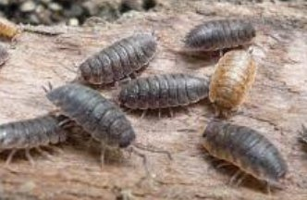
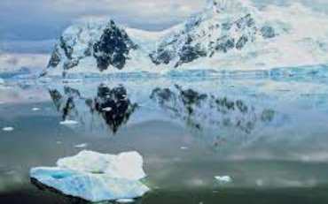
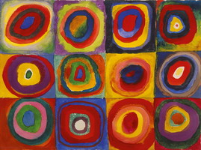
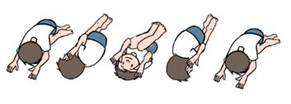


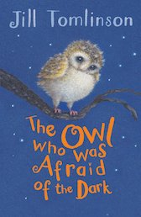
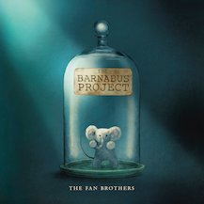
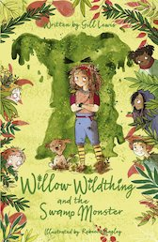

Science
In science the children will be learning how to identify and classify if something is alive, was once alive or has never been alive. The children will be exploring what a habitat is, and what makes a good habitat for a variety of plants and animals. Finally, the children will investigate food chains and learn how to construct one.
Geography
This term in geography, the children will begin to answer the question 'Why doesn't anyone live in Antarctica permanently?' The children will learn to locate Antarctica and identify its seasons and climate. They will then begin to learn the different plants and animals that can be found in Antarctica.
Art
In art the children will be learning about abstract painting in the style of Kandinsky. They will start by learning about tints and tones before extending their knowledge of secondary colours by learning and creating tertiary colours on a colour wheel. They will then create their own concentric circle inspired art.
PE
This half term the children will be doing gymnastics. They will be developing their skills from year 1, mastering basic movements including running, jumping, throwing and catching. Alongside this, they will be developing balance, agility and co-ordination and begin to apply these in a range of activities.
Music
This half term the children will be learning that music has a pulse (steady beat). It is made up of long and short sounds called rhythm as well as high and low sounds known as pitch. The children will have the opportunity to learn to play either a recorder or a glockenspiel.
PSHE
In PSHE the children will be exploring the question: What jobs do different people have? They will be learning the reasons why people have jobs and how people choose their jobs too. They will also spend time considering which jobs they might like to do in the future.
Homework
Please ensure that your child uses Times Table Rockstars to practise their number facts at least five times per week. Thank you for all of your support with helping your child to read at home. Please make sure that they read their reading book at least four times a week. We ask that these books are brought back into school every Friday to be changed.
Suggested books for reading
The Owl Who Was Afraid of the Dark
by Jill Tomlinson
Barnabus Project by the Fan Brothers
Willow Wildthing and the Swamp Monster
by Gill Lewis

