Slide 1


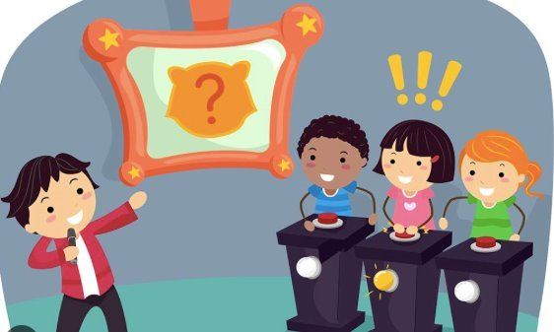
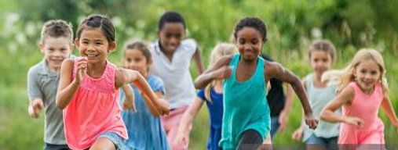
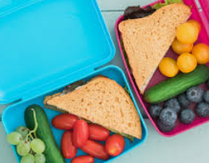
EYFS Newsletter
Summer 1 – 2025/26
Notices and Reminders
PE will continue to be on a Monday. The children are to come to school in their P.E. kit and remain in it for the day.
Please ensure that reading books are brought back to school on a Friday ready to be changed.
Key dates
April
Monday 13th – Back to school
Tuesday 21st - PTA Meeting 7.15pm
Thursday 23rd – St Georges Day
May
Monday 4th – Bank Holiday
Thursday 14th – Class Photos
Thursday 14th – Reception school trip
Friday 22nd – Last day of term 3.15pm pick up
Communication and Language
In this half term, the children will be learning how to ask a question using who, what, where, why, when and how as a starting point. Through Talk for Writing, the children will be learning to use connectives to link their ideas together. The children will also continue to learn a range of rhymes and songs to support their learning.
Physical Development
The children will continue to practise curly letters, zig‑zag letters, one‑armed robot letters and long ladder letters, helping them develop control and confidence in their letter formation. They will continue to work on their scissor grip and cutting skills.
The children will develop their balancing skills on apparatus and practice traveling around, over and through apparatus to build their coordination and confidence. The children will learn how to jump safely from a height by focusing on technique and safety.
Personal, Social and Emotional Development
This term the children will be learning about how they are similar and different to each other and use this knowledge to complete a challenge successfully as a team. They will then learn about how to be healthy, thinking about exercise, diet and keeping clean!

Slide 2
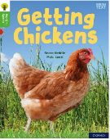

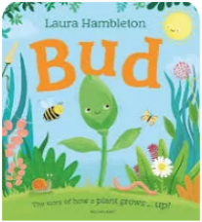

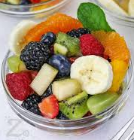


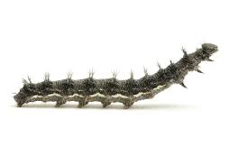
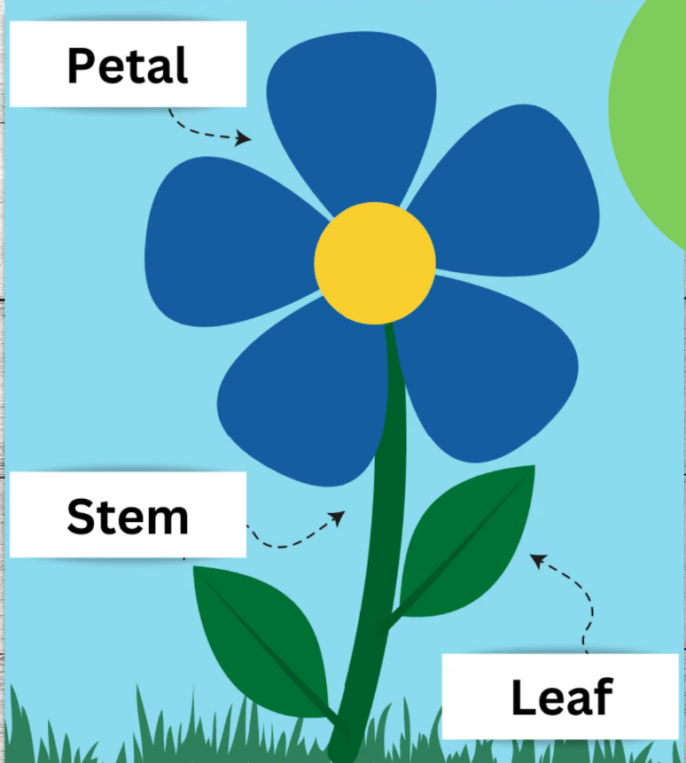
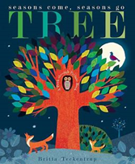

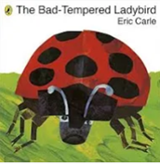
Literacy
The core texts will support the children in developing their writing skills focusing on using capital letters at the beginning of a sentence, leaving spaces between words, and using full stops to mark the end of a sentences.
In phonics, the children will begin to read words with suffixes. A suffix is a small ending added to a word—like ‑ing or ‑ed—and they will be practising how to spot these and blend the whole word together.
Mathematics
The children will begin to build numbers beyond ten. They will use resources to support their understanding of numbers to 20 and beyond. They will explore increasing and decreasing amounts through addition and subtraction.
The children will explore how shapes appear when they are moved, turned, rotated and flipped to fill a space. They will investigate how shapes can be combined or separated to make new shapes
Understanding the World
This term, the children will continue to learn more about the world around them, including where they live and what it is like to live there. They will then explore other countries and beliefs, discussing how these may be similar or different to living in England.
Later in the term, the children will learn about what a plant needs to survive, the main parts of a plant, and its life cycle. They will also study the life cycle of caterpillars.
Expressive Arts and Design
This term the children will be learning about fruits from different countries and designing a salad to taste. The children will be taught how to add more detail to their drawings by looking closely at plants. They will learn how to join materials together to make a moving mechanism scene for an animal. The children will be learning to perform a dance routine and a poem.
Suggested books for reading

