Slide 1


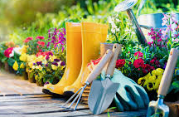






Nursery Newsletter
Summer 1—2025/2026
Notices and Reminders
If you would like to help the children plant flowers, herbs and vegetables please let a member of the team know.
Don’t forget to upload your Easter break fun onto Tapestry.
Key dates
Monday 13th April – start of term for Ladybirds
Wednesday 15th April – start of term for Butterflies
Wednesday 15th April – Millers Ark Farm visits nursery
(10.30-11.30 Ladybirds)
(12.30-1.30 Butterflies).
Important reminders –
Please check your child’s Tapestry journal each Friday for updates. These include a weekly round up and reminders for the week ahead. We have also begun our focus child cycle so please look out for when it is your child’s turn to bring in items for show and tell.
Please check the school website for links to the nursery timetable, recommended core texts and information on the curriculum.
Additional notices and diary dates can also be found in the newsletter which is emailed home to all parents every fortnight.
Communication and Language
Through our ready, steady, grow topic, the children will be continuing to learn new and exciting language. They will focus on asking and answering questions using who, what, where, why, when and how. The children will play games that help develop their understanding when following instructions that have one or two parts. The children will develop their imaginary and pretend play skills. They will also learn to communicate how they are feeling using words and actions.
Physical Development
This half term, the children will be focussing on developing their ball skills; bouncing and kicking. They will also have opportunities to explore different food tastes and textures. The children will continue to develop their fine motor skills, manipulating and moving objects using one-handed tools. They will practise mark making using zig zag, curved and wiggly patterns on different media.
Personal, Social and Emotional Development
This half term, the focus will be on the children growing a sense of self. They will confidently express their likes and dislikes and begin to think about healthy and unhealthy choices. Through circle times and play partners, the children will be supported in extending and contributing to collaborative play. The children will continue to use the Zones of Regulation to identify emotions.

Slide 2

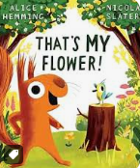
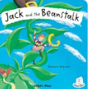
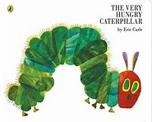

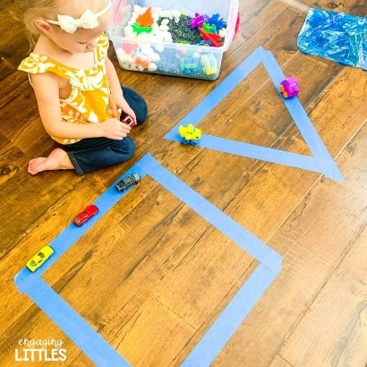
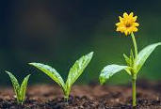





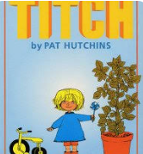
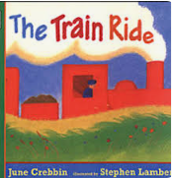
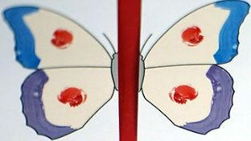
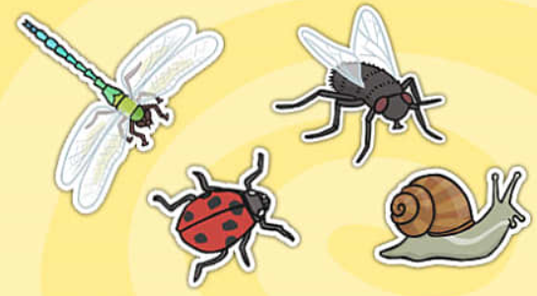
Literacy
This half term, the children will continue to develop early literacy skills through the core texts, ‘Jack and the Beanstalk’, 'That’s My Flower’ and ‘The Hungry Caterpillar’. They will use new vocabulary to develop storytelling through play. Through early phonics sessions, they will increase their awareness of words that rhyme and learn to produce rhyming words. Some children will be continuing their learning of Phase 2 sounds using our ELS Phonics Scheme.
Mathematics
This half term, the children will be thinking about ‘more’ and ‘less’. The children will compare two small groups of up to five objects, saying when there are the same number of objects in each group. They will then sequence events and think about their daily routines. They will revisit 2D and 3D shapes and continue to explore and talk about them through investigative play. The children will know the shape names and will use informal and mathematical language to describe these.
Understanding the World
The children will be exploring their natural world through the core books and learn about how things grow and change over time. The Very Hungry Caterpillar will help the children learn about how animals grow and make links to plant lifecycles. The children will plant their own seeds. They will also explore the seasons spring and summer and begin to describe differences in weather.
Expressive Arts and Design
The children will be developing their scissor skills and learning how to connect different materials when using junk modelling. They will be making their own minibeast houses using a variety of materials. Through the core books, the children will develop their own stories through role play and small world resources. There will be a focus on patterns and colour which will inform their paintings and drawings. The children will express their thoughts, feelings and ideas through painting and drawing. They will be supported by adults to draw with increasing complexity and detail.
Ideas for at home
Plant some seeds at home. What do you need to do to help them grow?
Think about your own name. What sound does it start with? Can you find things around the house that start with the same sound?
Visit a garden centre and look at what is growing. What colours can you see?
Go on an adventure with Jess from CBeebies
Minibeast Adventure with Jess - CBeebies - BBC
Suggested books for reading

