Slide 1


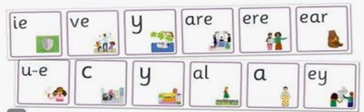
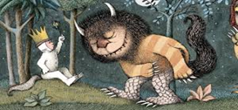


Year 1 Newsletter
Summer 1—2025/2026
Notices and Reminders
Owls PE is on Friday
Squirrels PE is on Thursday
Please continue to send books in book bags back to school on Fridays. This includes library books and school readers.
Key dates
April
Monday 13th – Back to school
Tuesday 21st - PTA Meeting 7.15pm
Thursday 23rd – St Georges Day
May
Friday 1st – Phonic Workshop (Teams) @ 9am
Monday 4th – Bank Holiday
Thursday 14th – Class Photos
Friday 22nd –
Last day of term 3.15pm pick up
Phonics
The children will be relearning and consolidating all sounds and spellings taught so far in preparation for the Phonics Screening Check in June.
Writing
In writing this half term, the children will be learning about non-fiction texts and will write a letter to The Night Pirates. Then they will write a story that is linked to 'Where the Wild Things Are'. They will also continue to work on using correct grammar and punctuation. The focus will be on using capital letters and exclamation marks correctly.
Maths
In maths this half term, the children will learn how to add equal groups, make arrays and how to make equal groups by sharing. The children will begin to learn about halves and quarters in their unit on fractions. They will also learn about position and direction using the terms 'forwards, backwards, left and right'. In our place value unit, the children will learn numbers to 100.

Slide 2
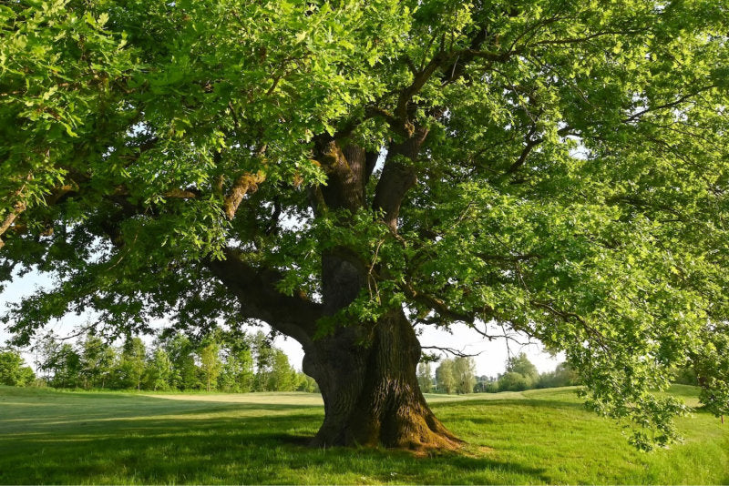
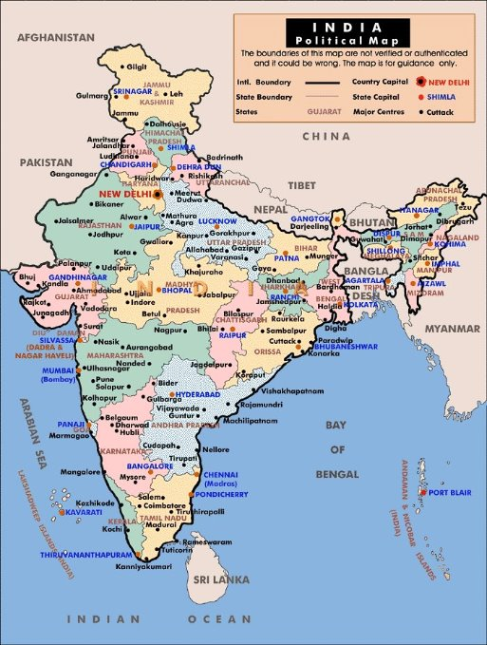

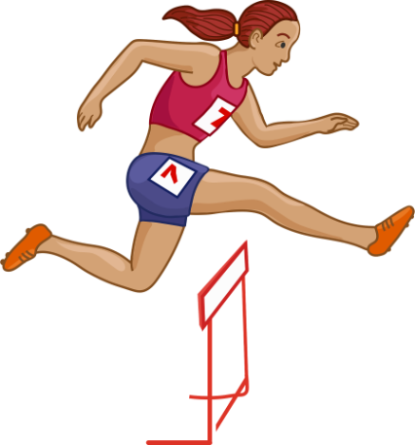




Science
In science this half term, the children will be learning about plants. The children will then learn to identify and name a variety of both wild and garden plants, including deciduous and evergreen trees. Finally, the children will investigate the question – do the tallest trees have the biggest leaves?
Geography
In geography this half term, the children will be learning about India. They will begin by learning the geographical features of the country, for example the river Ganges, the Himalayas and the surrounding seas. Then they will learn about the city of Senoi and compare it to the city of Guildford.
Music
In music this half term, the children will be exploring sound. They will learn that music is made up of high and low sounds, long and short sounds and loud and quiet sounds. The children will explore these sounds and create their own very simple melodies.
PE
In PE this half term the children will be focusing on athletics and mastering basic movements, including running, jumping, throwing and catching. They will also learn how to participate in a team relay and how to leap over obstacles. Existing knowledge on how to send and receive a ball will also be extended as the children will be learning to send and receive different pieces of equipment.
DT
In DT this half term, the children will be creating their own moving story books. They will learn about mechanisms and how they can make a picture move up and down as well as side-to-side using sliders. The children will think about who their target audience is and use this to help them to design, create and evaluate their own moving story books.
PSHE
In PSHE this half term, the children will be learning how to stay safe. They will look at staying safe both online and at home. The children will then be thinking about different ways in which they can be polite and kind to one another. The children will then think about the different responsibilities that they have.
Homework
As the deadline for Phonics Screening Check approaches, please continue to practice reading at home at least three times a week as well as any real / nonsense word flashcards that have been sent home.
Suggested books for reading

