Slide 1


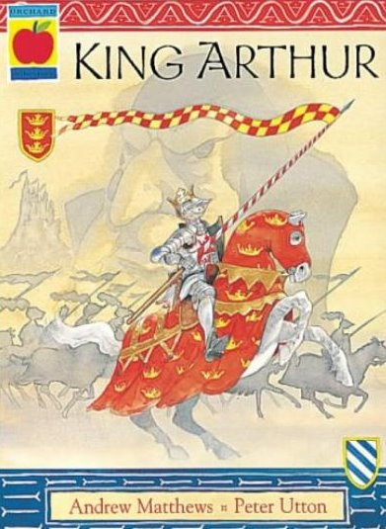
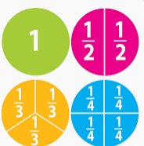
Year 2 Newsletter
Summer 1—2025/2026
Notices and Reminders
PE days are Tuesdays for Rabbits and Wednesdays for Foxes.
Please ensure your child brings a clearly named water bottle to school every day.
Thank you for your ongoing support.
Key dates
April
13.04.26 – Back to school
21.04.26 PTA Meeting 7.15pm
23.04.26 – St Georges Day
28.04.26 Multi Skills Festival at Prior Heath
May
07.05.26 Class photos
22.05.26
End of half term 3.15pm pick up
Parent Volunteers needed!
Can you spare any Monday afternoons to help us with our DT? We are learning to sew felt pouches and find making knots and threading needles really tricky! If you or any grandparents etc can spare one or more afternoons to help support our children, we would be most grateful.
We will also be looking for volunteers to accompany us to Frimley C of E after half term for our Picnic and Sports Afternoon.
If you can help, please email us at year2@sandringham.kite.academy.
Reading
This term, the children will continue reading 'King Arthur' retold by Andrew Matthews. They are enjoying this classic tale of adventure and enchantment as Arthur's adventures unfold. Mystery and treachery lurk in unexpected places as Arthur, the young High King of
Britain, and our children, learn
that not everything in the story is
as it seems... Who can be trusted
and how will it all end?
Writing
In writing, the children will learn to write a character description of the giant from Jack and the Beanstalk. They will then learn to write a persuasive leaflet about Pirate Island. The children will first learn the model text, then innovate the text as a class before finally innovating themselves. The children will learn how to use adverbs ending in ‑ly and practise adding commas to separate items in a list. They will also focus on using apostrophes for singular possession in their writing.
Maths
In the summer term, the children will continue their measurement work by exploring mass, capacity and temperature. They will then begin their fractions unit, learning about parts and wholes, equal and unequal parts, and recognising and finding halves, quarters and thirds. As they progress, they will also explore unit and non‑unit fractions, simple equivalences and counting in fractions up to a whole.

Slide 2
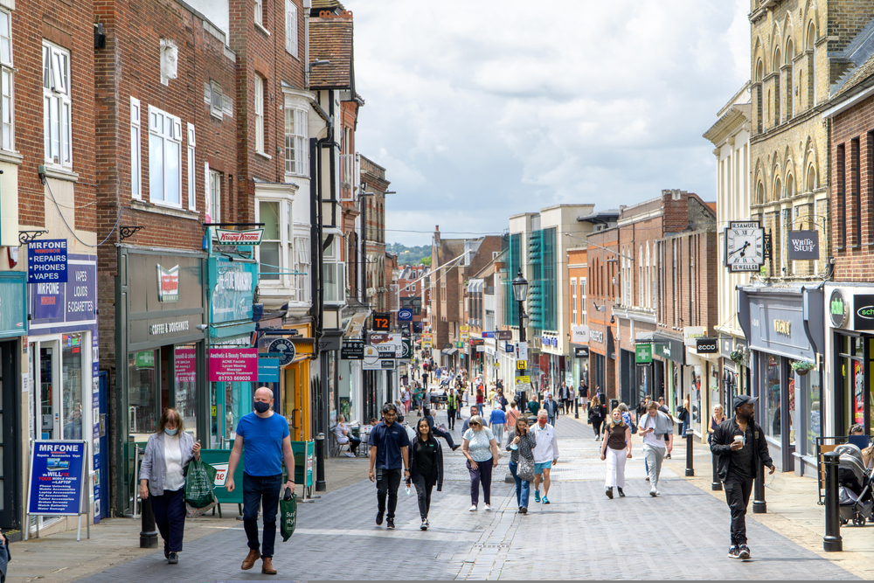


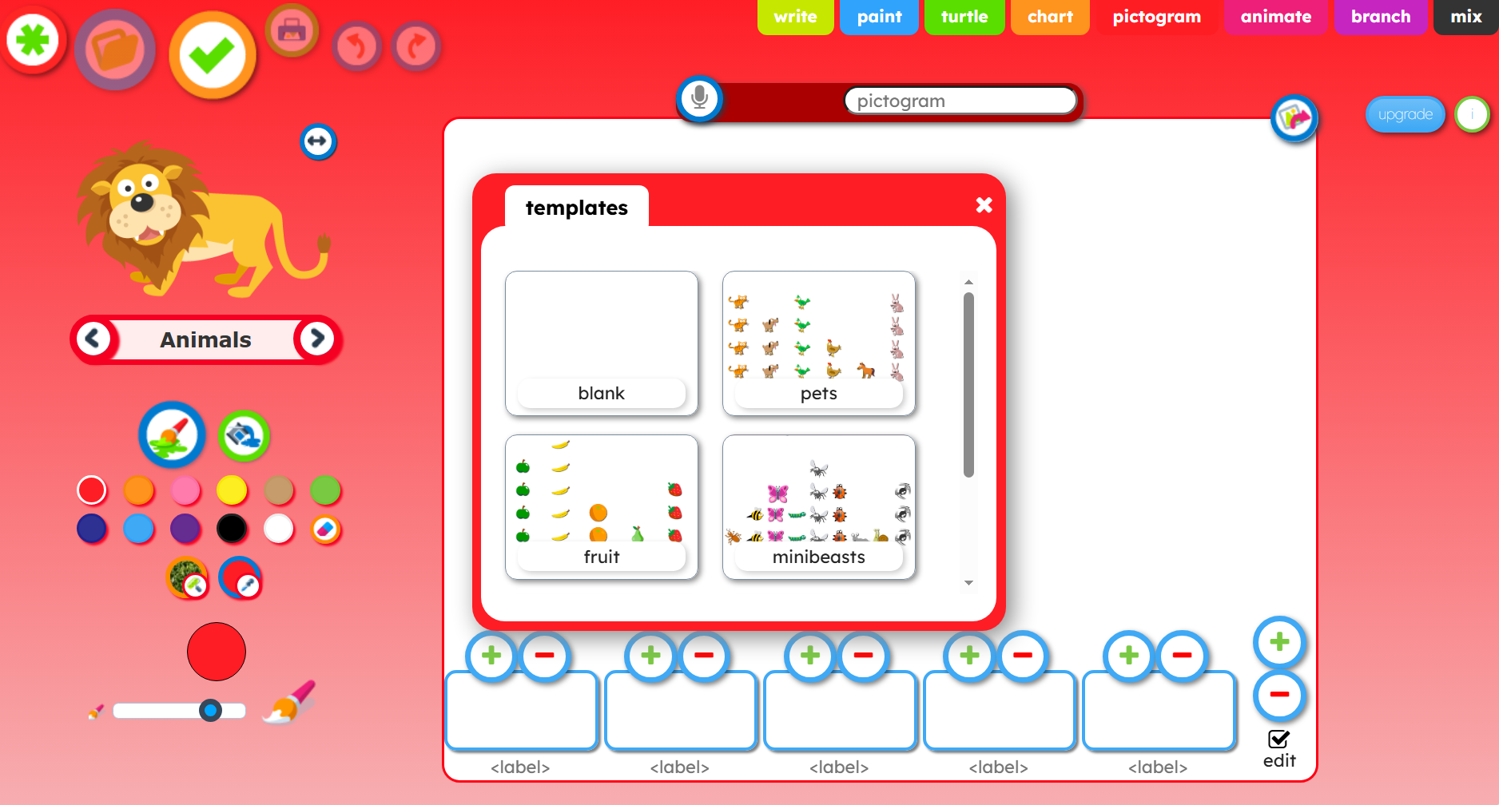

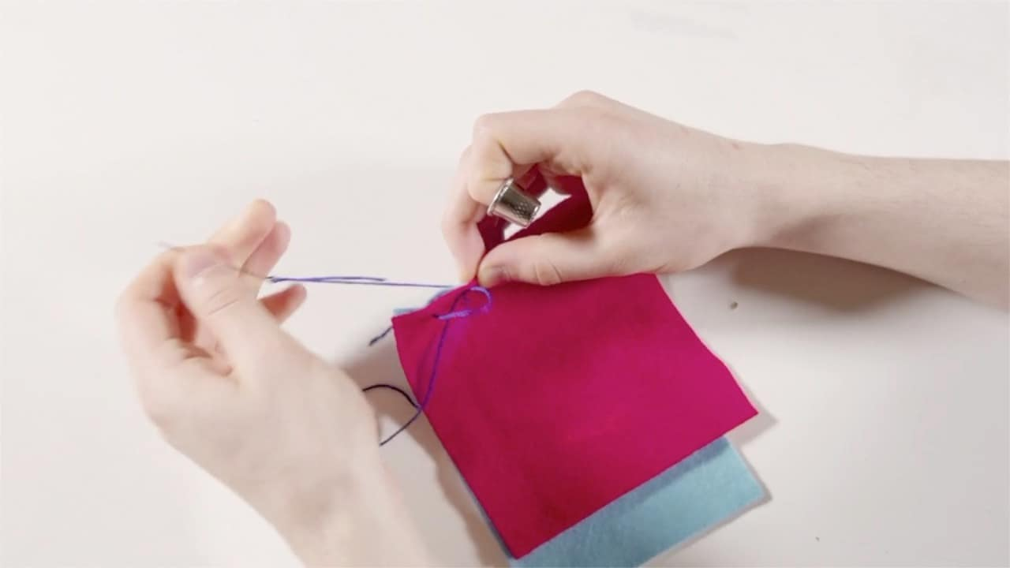
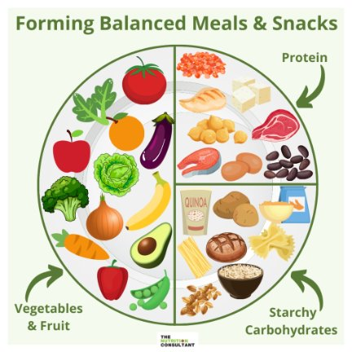

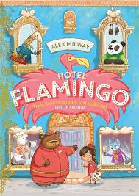
Science
In science, the children will be learning all about plants. They will learn about the parts of a plant, what a plant needs to grow and the lifecycle of a plant. They will also conduct a fair test to understand the best conditions to grow a seed and how it changes over time.
History
In history this half term, the children will be looking at how the high street has changed over time. They will be thinking about how shopping has changed from 1950-today. They will also be learning to draw a simple sketch map of their
local high street showing
changes over time.
Computing
In computing, the children will be using j2e pictogram software to purposefully create and organise data in a pictogram. The children will learn what an attribute is and how to collect data using attributes and present their data in other ways.
PE
In PE, the children will be learning athletics. They will learn how to master basic movements including running, jumping, throwing, and catching. They will also develop their balance, agility and coordination.
DT
In DT, the children will be learning about textiles and the skills needed to make pouches, such as how to thread a needle, sew a running stich and to sew small evenly spaced stitches. They will be designing, creating
templates, cutting
and sewing fabric,
decorating and
then evaluating
their finished pouches.
PSHE
In PSHE, the children will be looking at what helps us to grow and stay healthy. They will look at what makes a healthy balanced diet and how it is important to eat a range of fresh fruit and vegetables. The children will also look at how exercise helps us to
keep healthy and what
people need to keep their
minds healthy too.
Home Learning
Please read with your child every day
Please encourage your child to practise their times tables regularly on TTRockstars
Why not visit your local library?
Suggested books for reading

